Slide 1
Development Operations
Herunder Continuos Integration & Continuous Delivery

Slide 2
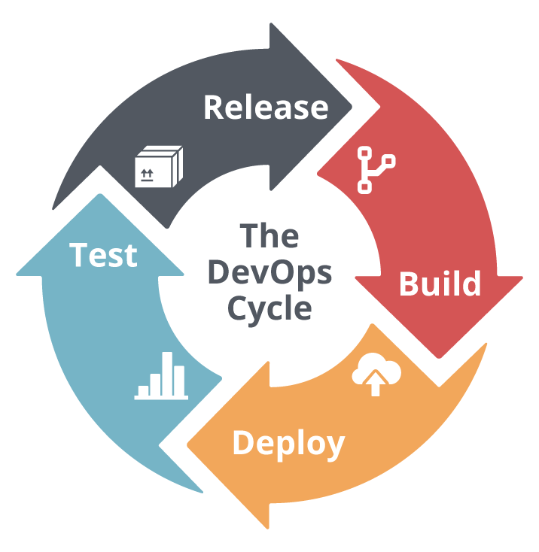
The flow
Code
Github
Jenkins(formerly Hudson)
Docker
Notes:
Build – i jenkins
Deploy – jenkins beder docker om at deploye
Test – jenkins
Release - github

Slide 3
Code is pushet to github
Github notifies Jenkins
Jenkins builds
Docker removes previous comntainer and image
Docker deploys the Jenkins build defined by build steps which in turn creates and image that is mounted to a container, which is run.

Slide 4
CI – Continuous Integration (Jenkins)
Hvilket problem skulle det løse?
Before CI the process was manual and taking up to hours
Prompting developers to ”integrate” rarely
Which in turn caused an imens amount of code ”conflicts”
Which was hard to pin point
CI er automatiseret
Jenkins med master – slave forhold
Test server, prod server, beta test server etc.

Slide 5
CD – Continuos Delivery (Docker)
kan kører i isoleret miljøer
Bruger Kernel i vores OS til at lave et image af f.eks. Ubuntu
Man kan bygge oven på et image
builder hurtigt da det bruger mange af komponenterne i samme kernel
man kan sandboxe, så en app altid kører i samme miljø (OS version), (JDK version)
Image er defineret af en Dockerfile
Container bliver bygget med build steps som kører imaget

